Slide 1
Croeso
Welcome
Rhieni fel Partneriaid
Parents as Partners
Mathemateg / Rhifedd
Mathematics / Numeracy

Slide 2
Beth yw’r gwahaniaeth
rhwng Mathemateg a Rhifedd?
What’s the difference between
Mathematics and Numeracy?
Numeracy is usually defined as the ability to use maths at the level needed to get by in everyday life. Using maths in everyday situations.

Slide 3
Mae disgyblion yn dysgu Mathemateg mewn 3 cham:
Concrît, Gweledol ac Haniaethol
(Adnoddau, pensil a phapur, mathemateg pen)
Pupils learn Mathematics in 3 steps:
Concrete, Visual and Abstract
(Resources, pen and paper, mental maths)

Slide 4
Diriaethol / Concrete
Adnoddau / Resources
NUMICON
0
sero
1
un
2
dau
3
tri
4
pedwar
5
pump
6
chwech
7
saith
8
wyth
9
naw
10
deg

Slide 5
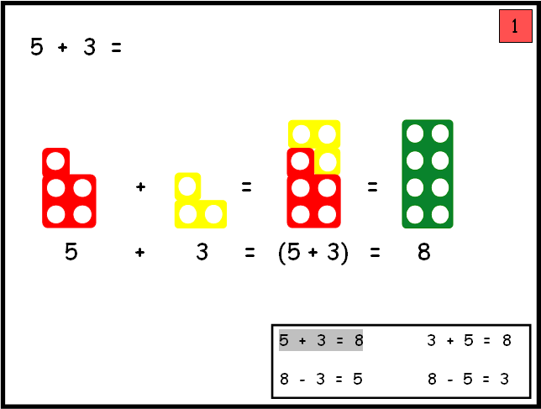

Slide 6
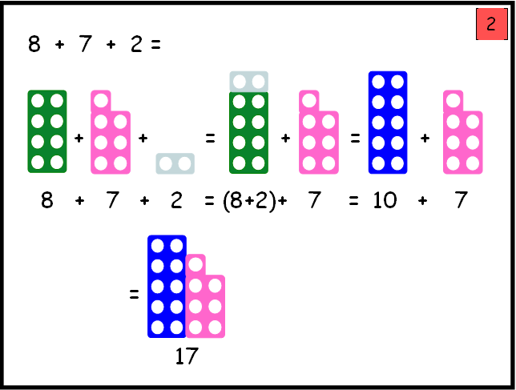

Slide 7
Gweledol / Visual
Pensil a Phapur / Pen and Paper
2 + 8 = 10
10 – 8 = 2
2 x 8 = 16
16 ÷ 8 = 2

Slide 8
Haniaethol / Abstract
Wedi dysgu
Mathemateg pen
Gwneud cysylltiadau
Learnt
Mental maths
Make connections

Slide 9
ail isradd 64
3 yn fwy na 5
9 yn llai 17
nid yw’n lluosrif
o 3, 5 na 7
nid yw’n odrif
8
cyfanswm 3.23 a 4.77
3 adio 3 adio 3 tynnu 1
chwarter 32
un yn llai na 3 sgwâr

Slide 10
Addysgu a Dysgu
Mathemateg a Rhifedd
yn YGG Pontybrenin
Teaching and Learning
Mathematics and Numeracy
in YGG Pontybrenin

Slide 11
Datblygiad Mathemategol CS
Gwersi Mathemateg CA2
Y Cwricwlwm Cenedlaethol
ar gyfer Mathemateg yng Nghymru
Defnyddio a Chymhwyso, Rhif
Siâp, Gofod a Mesurau, Trin Data
Mathematical Development FP
Mathematics Lessons KS2
The National Curriculum
For Mathematics in Wales
Using and Applying, Number and Algebra, Shape,
Space and Measure, Handling Data

Slide 12
Y Fframwaith Rhifedd
Defnyddio Sgiliau Mathemategol yn
drawscwricwlaidd
The Numeracy Framework
Using Mathematical skills during
Cross-curricular activities

Slide 13
Profion Rhifedd Cenedlaethol
Gweithdrefnol a Rhesymu
Blwyddyn 2 i 6
National Numeracy Tests
Procedural and Reasoning
Years 2 to 6

Slide 14
Sut allwn wella?
How can we improve?
Cynllun Mathemateg C.D.D.C.
C.L.I.C. Mathematics Plan
Cyfnod Allweddol 2
Key Stage 2

Slide 15
Beth yw C.L.I.C?
What is C.L.I.C?
Cynllun systematig sy’n arwain unigolyn i fod yn rhifog.
Y bwriad yw gwneud mathemateg yn hawdd trwy dangos ei fod yn pwnc rhesymegol sy’n dilyn trefn penodol o gynnyd.
A systematic plan that leads an individual to be numerate.
It aims to make mathematics simple by showing that it’s a logical subject that follows a progression of patterns.

Slide 16
C.L.I.C.
Counting – Learning to count
Learn it’s – Learning to remember sums as facts
It’s nothing new – Learning to use facts in different situations
Calculation – Learning to structure all three previous steps in formal calculations
(+ - ÷ x)
Cyfrif – Dysgu i gyfrif
Dysgu ffeithiau – Dysgu i gofio symiau fel ffeithiau
Dim byd newydd – Dysgu i ddefnyddio’r ffeithiau mewn sefyllfa gwahanol
Cyfrifo – Dysgu i strwythuro bob un o’r tri blaenorol yn gyfrifiad ffurfiol
(+ - ÷ x)

Slide 17
Sesiynau CLIC yn yr ysgol CA2 (Bl 3 i 6)
4 Sesiwn dyddiol o 20 munud
4 agwedd CLIC (5 munud yr un)
Disgyblion wedi grwpio / ffrydio o fewn 2 flwyddyn ysgol
CLIC Session in school KS2 (Yr 3 to 6)
4 daily sessions of 20 minutes
4 aspects of CLIC (5 minutes on each aspect)
Pupils grouped / streamed within 2 school years

Slide 18
Cyfrif / Counting
Dysgu i gyfrif / Learning to count
Dilyniant / Sequence
Ymlaen ac yn ôl / Forwards and backwards
Camau gwahanol / Different sized steps
Odrifau ac eilrifau / odd and even numbers

Slide 19
2. Dysgu Ffeithiau / Learn it
Dysgu i gofio symiau fel ffeithiau /
Learning to remember sums as facts
Bondiau rhif a Ffeithiau lluosi /
Number bonds and Multiplication facts
Parau / Pairs
Dyblau ac haneri / Doubles and Halves
Adio a thynnu / Addition and subtraction
Ffeithiau lluosi a rhannu / Multiplication and division facts
Degolion / Decimals

Slide 20
3. Dim Byd Newydd
It’s Nothing New
Dysgu i ddefnyddio’r ffeithiau mewn sefyllfa gwahanol /
Learning to use facts in different situations
5 + 5 = 10
50 + 50 = 100
500 + 500 = 1000
Mesur / Measure 50cm + 50cm = 100cm
Arian / Money 50p + 50p = 100p or £1.00
Amser / Time 60 mins = 1 hour
Half an hour = 30 mins

Slide 21
4. Cyfrifo / Calculation
Dysgu i strwythuro bob un o’r tri blaenorol yn gyfrifiad ffurfiol
Learning to structure all three previous steps in formal calculations
Adio, Tynnu, Lluosi a Rhannu
(+ - ÷ x)
Addition, Subtraction, Multiplication and Division

Slide 22
Sialens Mathemateg Personol:
‘Ar Eich Marciau’
‘Ewch Amdani’
Personal Maths Challenge:
‘On Your Marks’
‘Go For It’

Slide 23
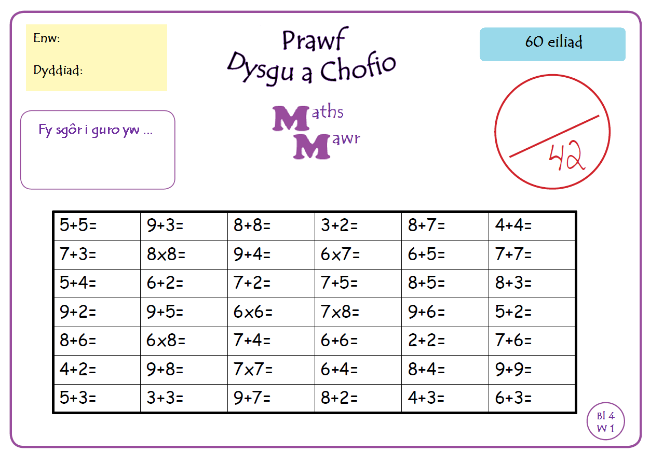
Sialens wythnosol ‘ Dysgu a Chofio’
10
12
16
5
15
8
10
64
13
42
11
14
9
8
9
12
13
11
11
14
36
56
15
7
14
48
11
12
4
13
6
17
49
10
12
18
8
6
16
10
7
9
Notes:
10 ardal i
23

Slide 24
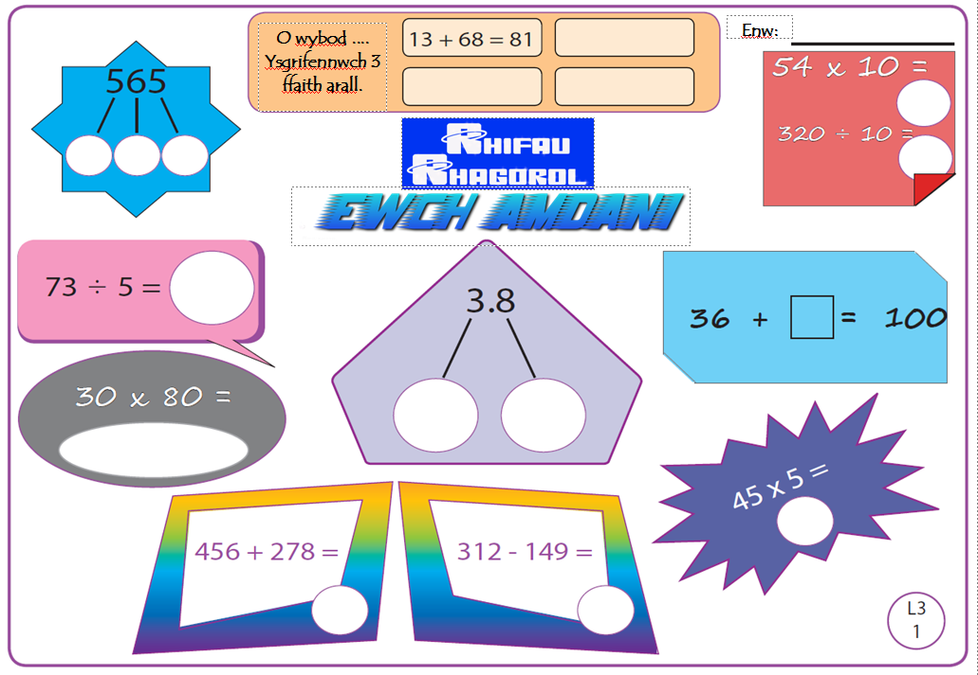
Sialens Wythnosol Ewch Amdani

Slide 25
Sut allwch chi cefnogi mathemateg a rhifedd tu allan i’r ysgol?
How can you support mathematics and numeracy outside of school?

Slide 26
Helpwch eich plentyn fod yn rhifog drwy ymarfer agweddau CLIC ac i ddefnyddio’r sgiliau’n ymarferol
Mesur – Hyd, Pwysau / Mάs a Chynhwysedd
Amser – Analog a Digidol
Arian – Cost, Newid a Chynilo
Ffracsiynau, Canrannau a Degolion
Help your child be numerate by practicing aspects of CLIC
and transfer the skills to practical situations.
Measure – Length, Weight / Mass and Capacity
Time – Analogue and Digital
Money – Cost, Change and Saving
Fractions, Percentages and Decimals

Slide 27
Maths is Maths
Don’t be afraid of teaching maths to your child,
using the same methods that you were taught!
Having the ability to use a range of mathematical methods will make it easier for your child to become numerate!
It’s the understanding of how to get the answer that’s important!
The School Website / Gwefan yr ysgol
yggpontybrenin.com
Diolch am wrando!
Thank You!

Slide 28
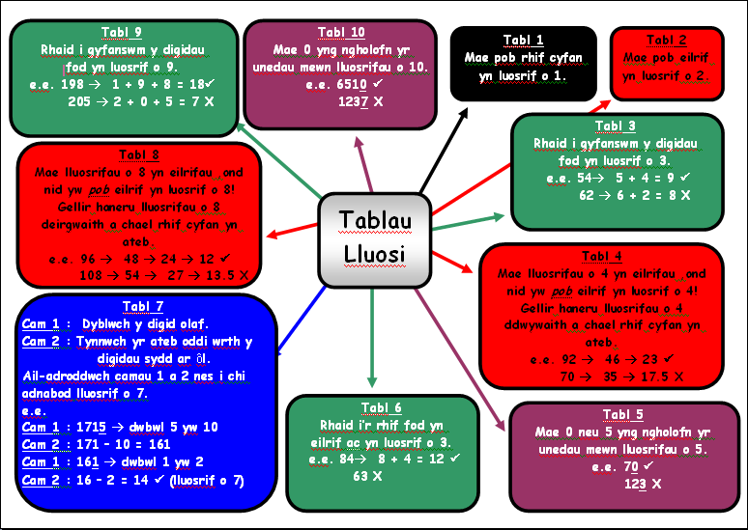

Slide 29
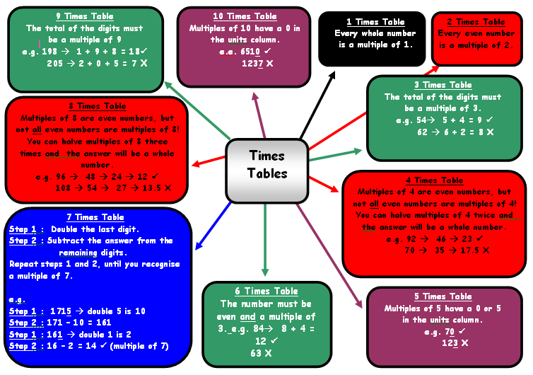

Slide 30
-21 | -20 | -19 | -18 | -17 | -16 | -15 | -14 | -13 | -12 | -11 | -10 | -9 | -8
-11 | -10 | -9 | -8 | -7 | -6 | -5 | -4 | -3 | -2 | -1 | 0 | 1 | 2
-1 | 0 | 1 | 2 | 3 | 4 | 5 | 6 | 7 | 8 | 9 | 10 | 11 | 12
9 | 10 | 11 | 12 | 13 | 14 | 15 | 16 | 17 | 18 | 19 | 20 | 21 | 22
19 | 20 | 21 | 22 | 23 | 24 | 25 | 26 | 27 | 28 | 29 | 30 | 31 | 32
29 | 30 | 31 | 32 | 33 | 34 | 35 | 36 | 37 | 38 | 39 | 40 | 41 | 42
39 | 40 | 41 | 42 | 43 | 44 | 45 | 46 | 47 | 48 | 49 | 50 | 51 | 52
49 | 50 | 51 | 52 | 53 | 54 | 55 | 56 | 57 | 58 | 59 | 60 | 61 | 62
59 | 60 | 61 | 62 | 63 | 64 | 65 | 66 | 67 | 68 | 69 | 70 | 71 | 72
69 | 70 | 71 | 72 | 73 | 74 | 75 | 76 | 77 | 78 | 79 | 80 | 81 | 82
79 | 80 | 81 | 82 | 83 | 84 | 85 | 86 | 87 | 88 | 89 | 90 | 91 | 92
89 | 90 | 91 | 92 | 93 | 94 | 95 | 96 | 97 | 98 | 99 | 100 | 101 | 102
99 | 100 | 101 | 102 | 103 | 104 | 105 | 106 | 107 | 108 | 109 | 110 | 111 | 112
109 | 110 | 111 | 112 | 113 | 114 | 115 | 116 | 117 | 118 | 119 | 120 | 121 | 122

