Slide 1
Weekly Talk Topics
Testun Trafod Wythnosol
‘If a child can’t say it, a child can’t write it!’

Slide 2
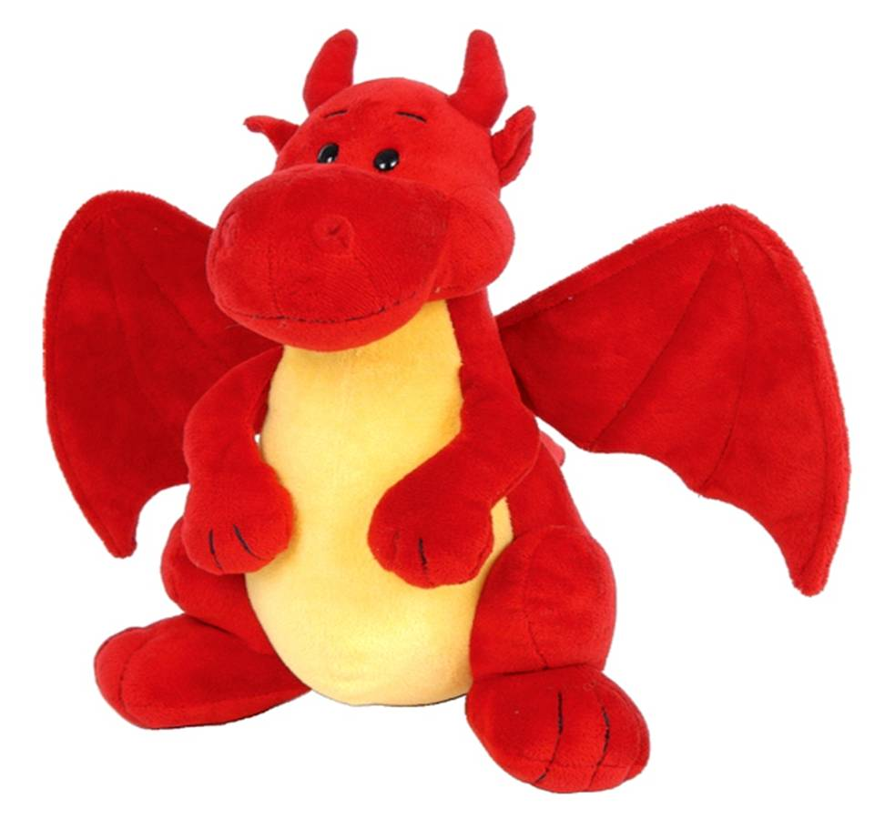
The best thing about being Welsh is…
Y peth gorau am fod yn Gymro/Gymraes yw…

Slide 3

Cardiff City – red or blue?
Dinas Caerdydd – coch neu las?

Slide 4
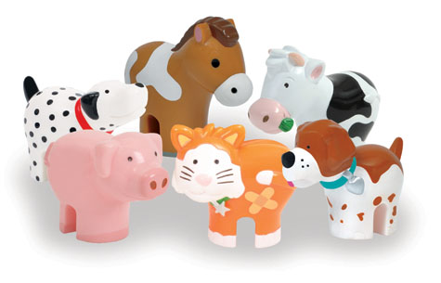
The pet I would most like to have is…
Anifail anwes yr hoffwn gael yw…

Slide 5
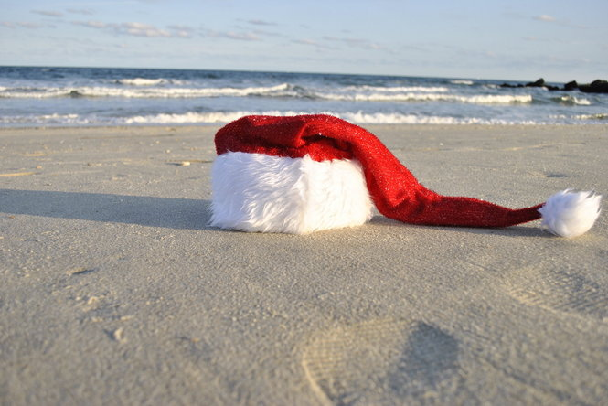
What does Santa Claus do in January?
Beth mae Siôn Corn yn gwneud yn ystod mis Ionawr?

Slide 6
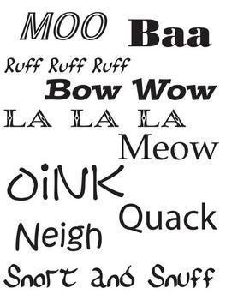
If animals could talk they would probably say…
Petai anifeiliaid yn gallu siarad, byddan nhw’n debygol o ddweud…

Slide 7

Who will win X Factor this year?
Pwy sy’n mynd i ennill X Factor eleni?

Slide 8
Who’s your favourite X Factor judge?
Pwy yw eich hoff feirniad ar X Factor?

Slide 9
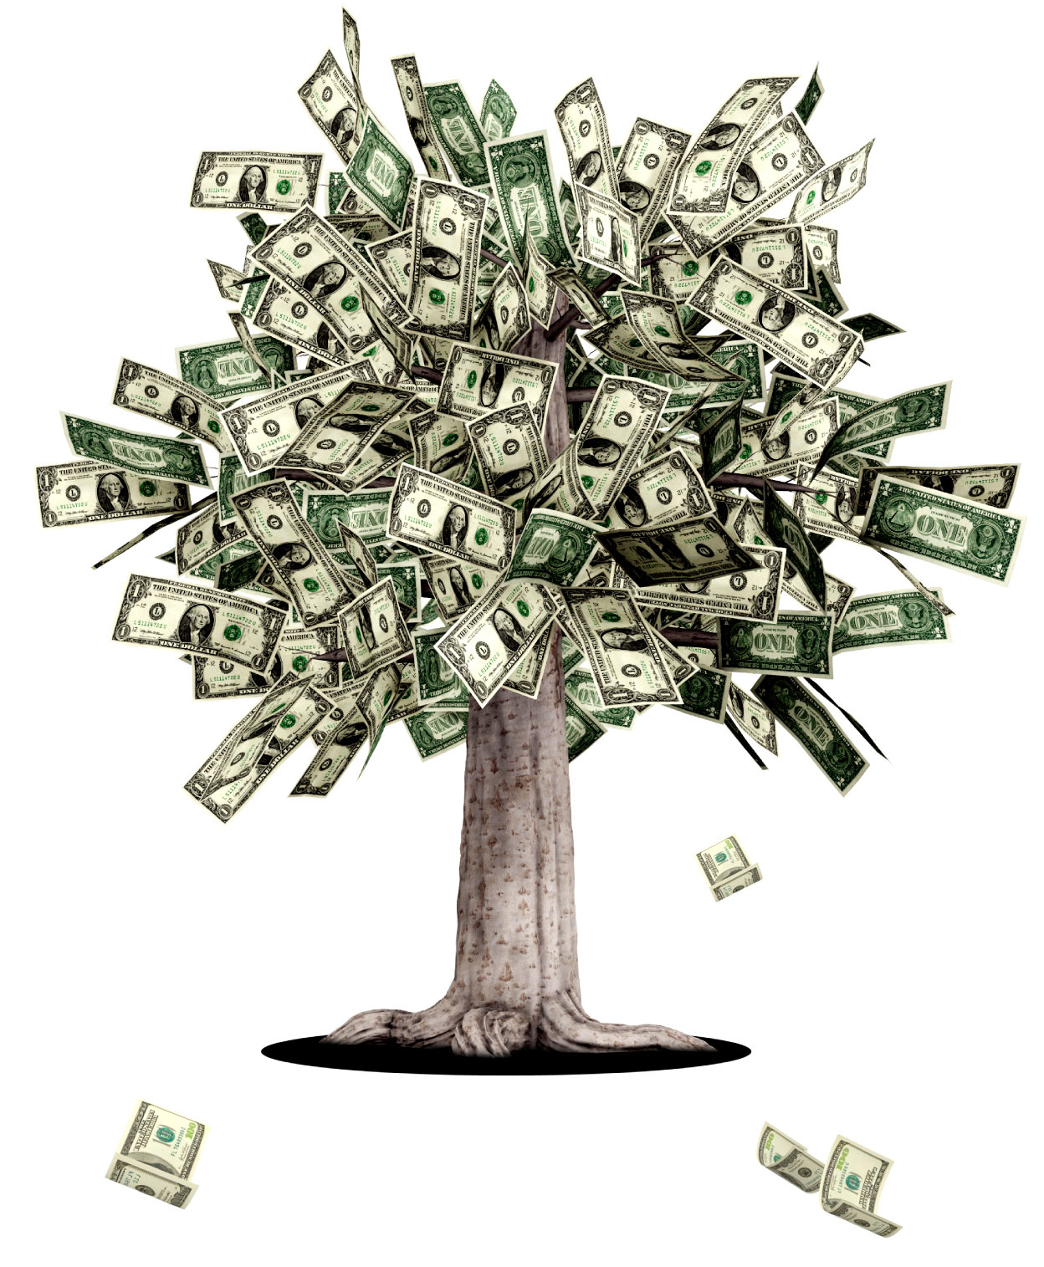
If I had a million pounds I would…
Petawn i’n filiwnydd, fyddwn i’n…

Slide 10

The best place I’ve ever been is…
Y lle gorau i mi fod erioed yw…

Slide 11
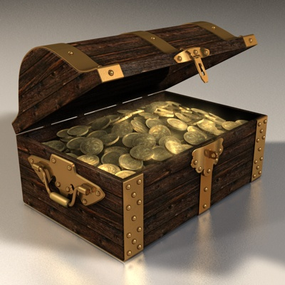
My most treasured possession is…
Yr hyn rydw i’n ei drysori fwyaf yw…

Slide 12

If I ruled Wales I would…
Petawn i’n arweinydd ar Gymru…

Slide 13
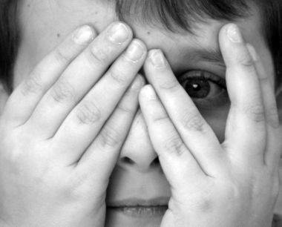
I’m afraid of…
Mae gen i ofn…

Slide 14
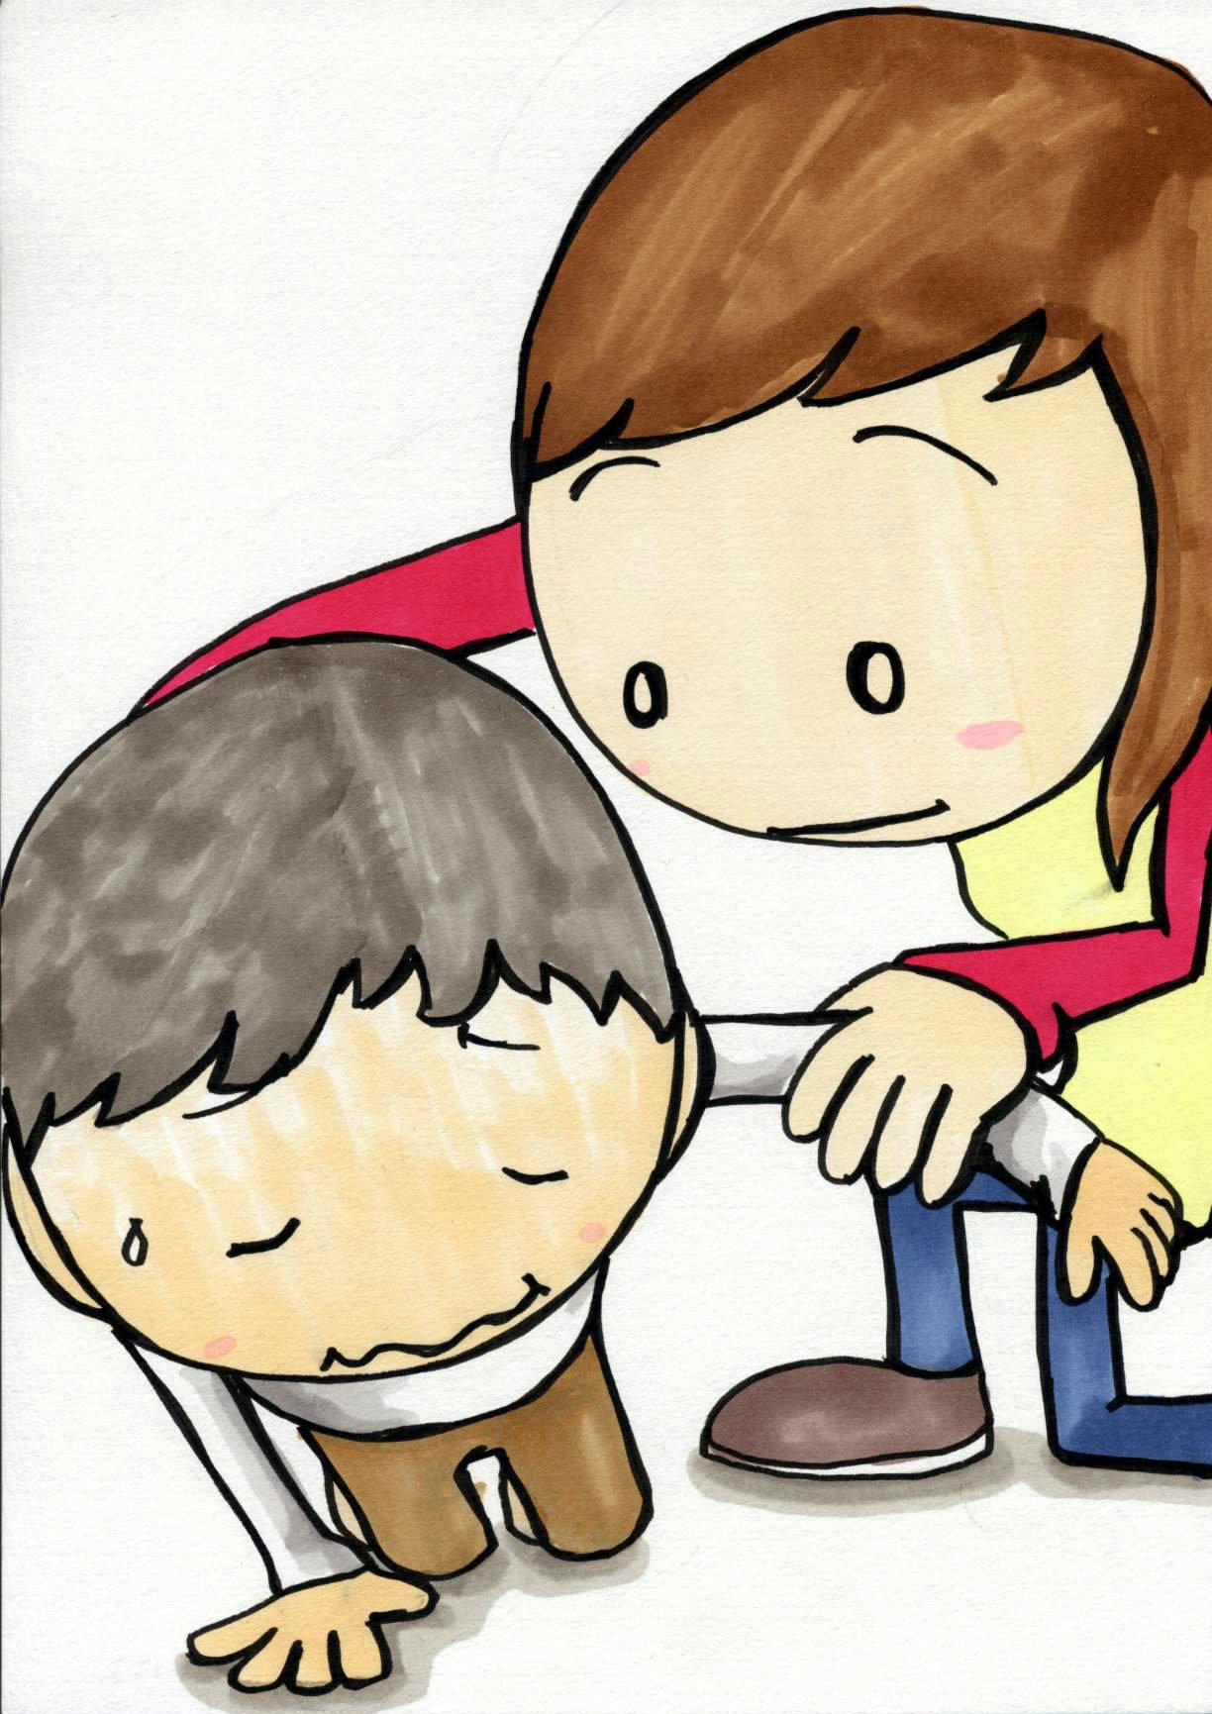
A good deed I’ve done is…
Cymwynas dda y gwnes i oedd…

Slide 15

My favourite colour is… because…
Fy hoff liw i yw… oherwydd…

Slide 16
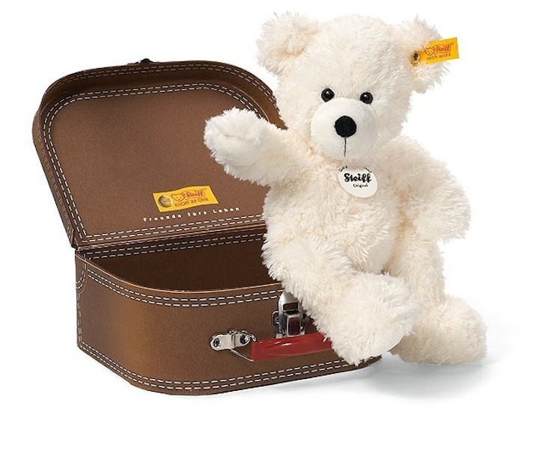
A place I would really like to visit is…
Carwn gael ymweld â…

Slide 17
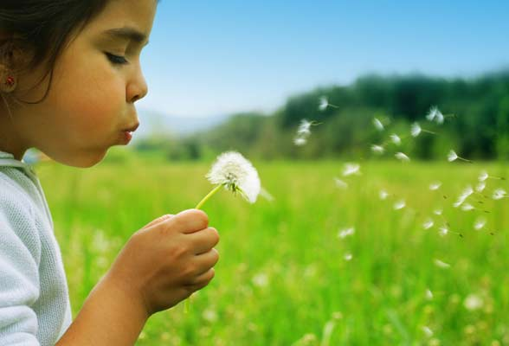
If I had three wishes…
Petai gen i dri dymuniad…

Slide 18
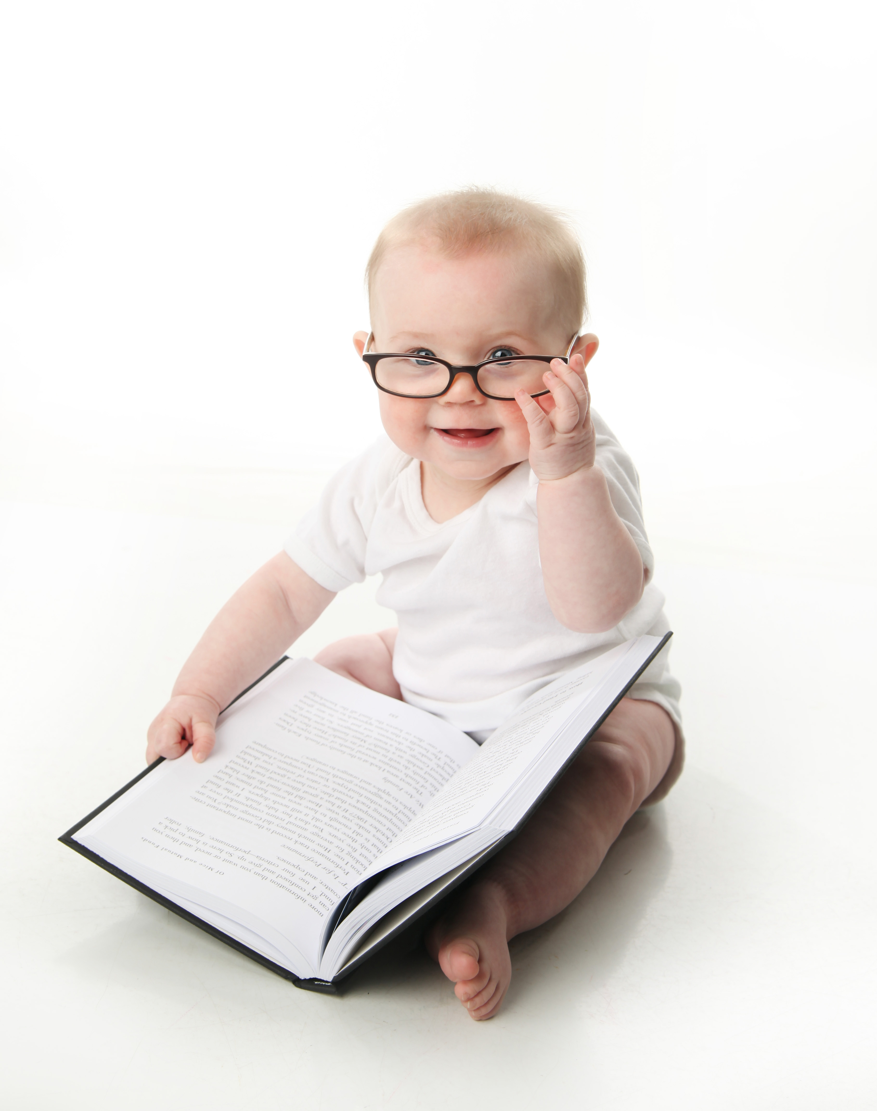
My earliest memory is…
Fy atgof cyntaf i yw…

Slide 19

The achievement I’m most proud of is…
Rydw i’n hynod falch fy mod wedi llwyddo i…

Slide 20
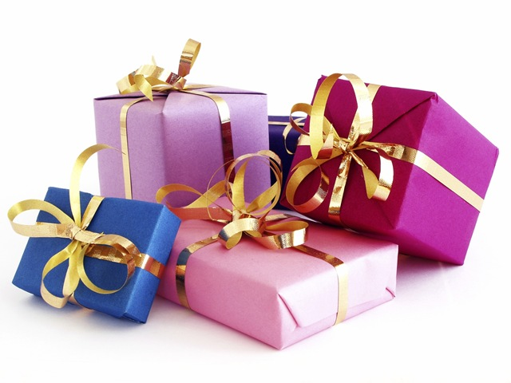
The best present I ever received is…
Yr anrheg orau ges i erioed yw…

Slide 21
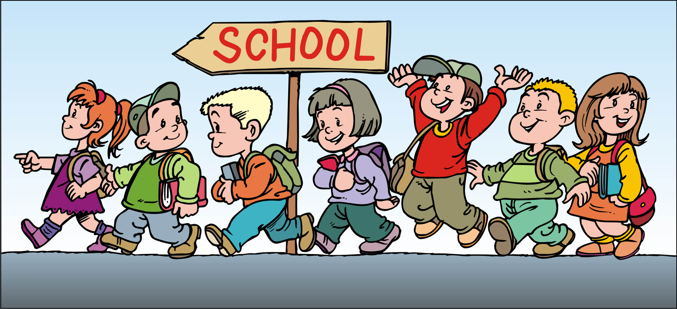
The best thing about this school is…
Y peth gorau am yr ysgol hon yw…

Slide 22

Something you may not know about me is…
Rhywbeth dydych chi ddim yn gwybod amdana i yw…

Slide 23
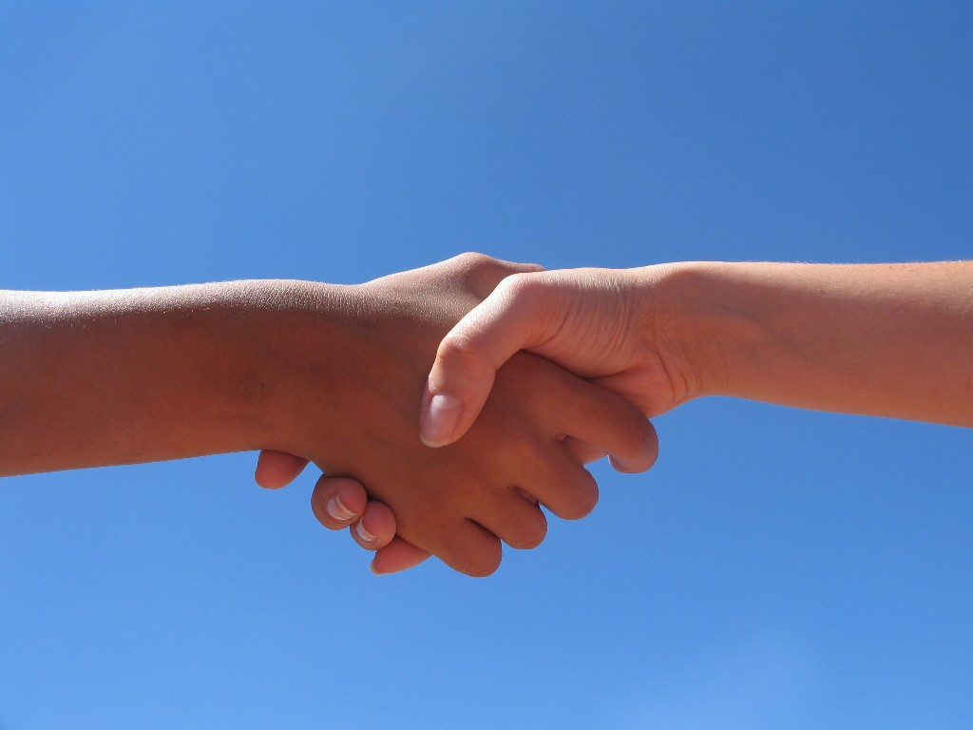
One person I would love to meet is…
Un person y carwn gael cwrdd ag ef/hi yw…

Slide 24
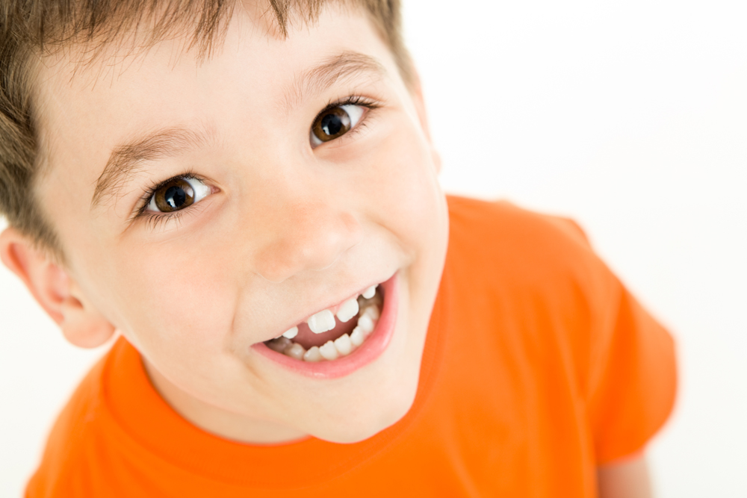
The best day of my life so far is…
Diwrnod gorau fy mywyd hyd yn hyn yw…

Slide 25
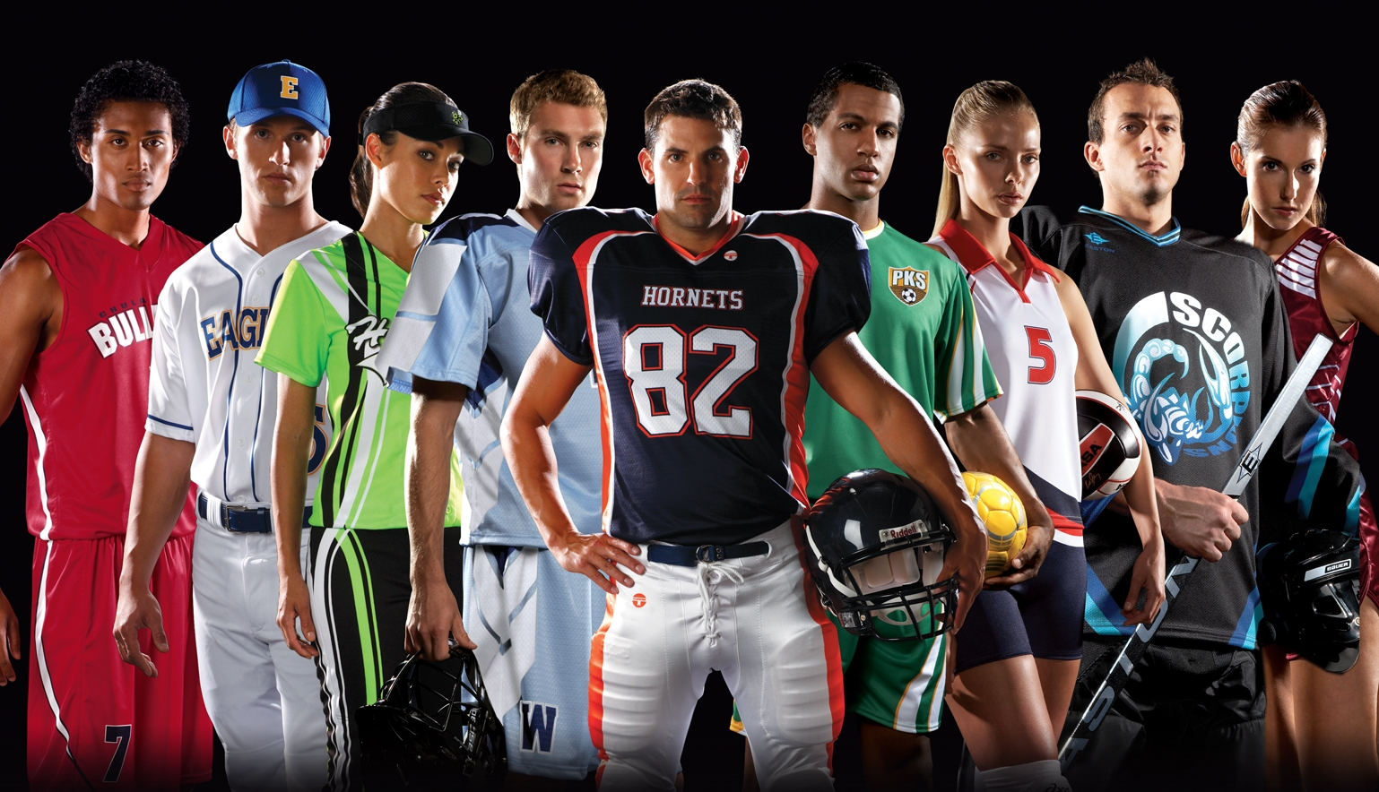
The best sport in the world is…
Y chwaraeon gorau ym myd y campau yw…

Slide 26

Who deserves to win Strictly this year? Why?
Pwy sy’n haeddu ennill Strictly eleni? Pam?

Slide 27
Who’s your favourite judge on Strictly? Why?
Pwy yw eich hoff feirniad ar Strictly? Pam?

Slide 28
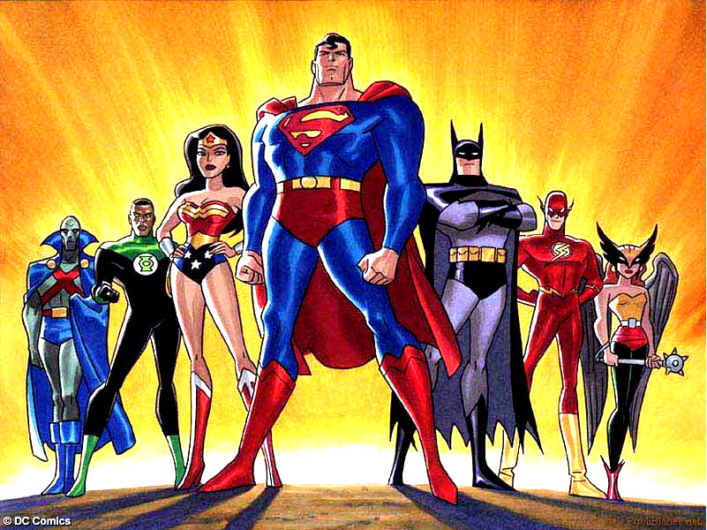
Which hero is the best? Why?
Pa arwr yw’r gorau? Pam?

Slide 29

Who will win The Voice this year?
Pwy sy’n mynd i ennill The Voice eleni?

Slide 30
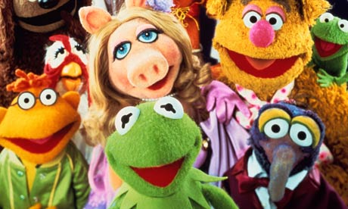
Who’s your favourite Muppet? Why?…
Pwy yw eich hoff gymeriad ar y ‘Muppets’? Pam?

Slide 31
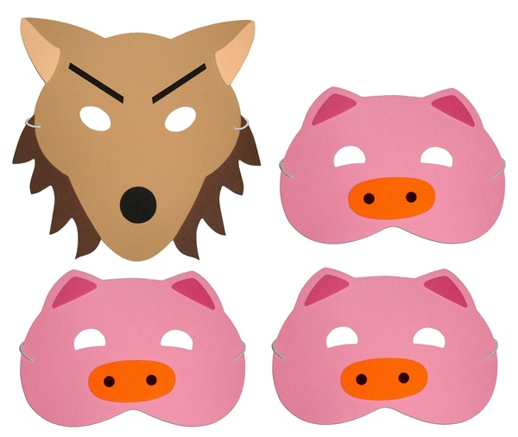
What’s your favourite fable? Why?…
Beth yw eich hoff chwedl? Pam?

Slide 32
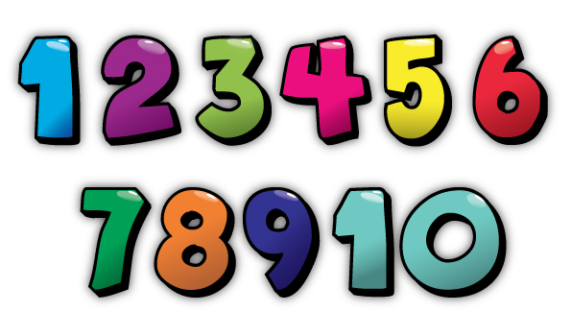
Do you have a lucky number? Which one is it?
Oes gennych chi rif lwcus? Pa un ydy e?

Slide 33
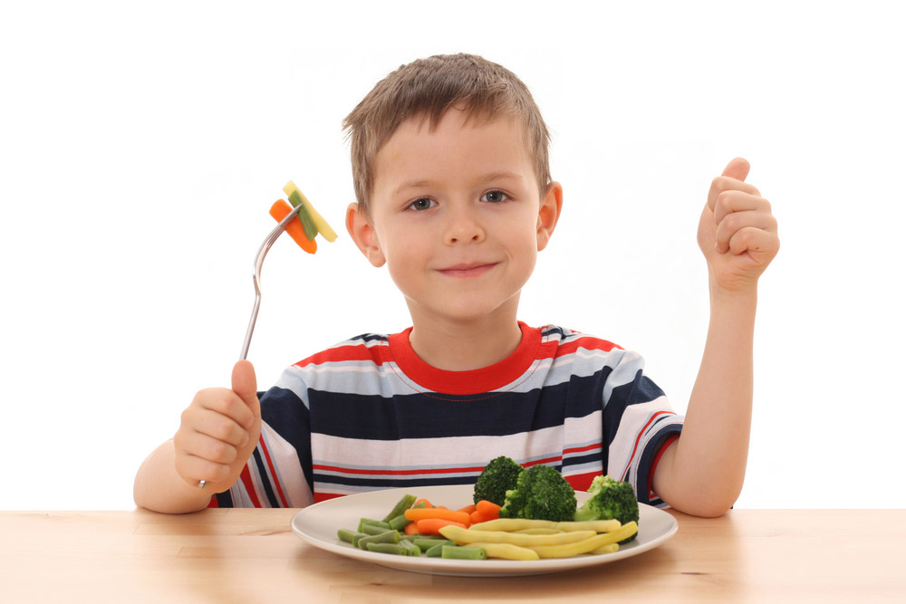
My ideal meal would be…
Y pryd o fwyd delfrydol i mi fyddai…

Slide 34

My favourite day of the week is…
Fy hoff ddiwrnod o’r wythnos yw…

Slide 35

My favourite book ever is…
Fy hoff lyfr erioed yw…

Slide 36
My favourite author is… because…
Fy hoff awdur yw… oherwydd…

Slide 37

One day, I would love to be a…
Pan rydw i’n hŷn, carwn fod yn…

Slide 38

The best month of the year is… because..
Mis gorau’r flwyddyn yw… oherwydd…

Slide 39

My favourite weather is… because…
Fy hoff fath o dywydd yw… achos…

