Slide 1
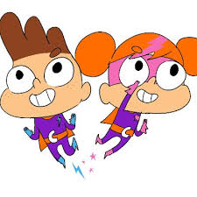
Mae Seren a Sbarc yma i wneud sgyrsiau gyda'ch plentyn am thema y tymor yn llawer haws!
Seren and Sbarc are here to make discussions with your child about their theme for the term much easier!
Ein thema:
Ffaith i ti!
Our theme:
A fact for you!
Cymraeg: Ffeithiol Ffuglen | Saesneg: Fact Fiction
Cymraeg: Unigol a lluosog, e.e. siarc, siarcod | Saesneg: Singular and plural, e.g. shark, sharks
Cymraeg: Ffotograff, darlun.
Saesneg: Photograph, drawing
Cymraeg: Mwyaf, lleiaf ac ati.
Saesneg: Biggest, smallest etc
Cymraeg: Barn | Saesneg: Opinion
Cymraeg: Cynnwys | Saesneg: Content
Cymraeg: Diddordeb | Saesneg: Interest
Cymraeg: Llyfrgell | Saesneg: Library

